Slide 1
Understanding Current Federal Tax Credit Opportunities & The Budget making Process

Slide 2
AGENDA
Welcome
Introduction
Federal budget making
IRA and other incentives
State budget making
Q+A

Slide 3
FEDERAL “RECONCILIATION BILL”
Last week, the US House of Representatives passed a large “reconciliation bill” that includes proposals for taxes, spending and changes to existing federal programs
It is unofficially called the “One, Big Beautiful Bill Act”
It now will be considered by the US Senate
Photo from Google Images

Slide 4
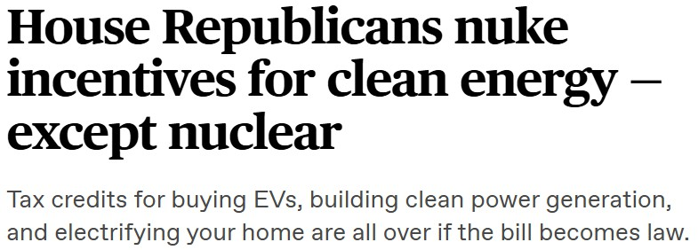
IMPACT ON CLEAN ENERGY
The House Bill proposes to significantly restrict or eliminate many of the clean energy incentives created by the 2022 Inflation Reduction Act.
https://www.canarymedia.com/articles/po
litics/house-republicans-nuke-incentives- for-clean-energy-except-nuclear

Slide 5
IMPACT ON CLEAN ENERGY
“Two major losses in the House bill are the production and investment tax credits for clean power projects known as 45Y and 48E”
“Clean power projects would have to start construction within 60 days of the bill being signed into law to be eligible for the incentives and start service by the end of 2028.”
tax credits for homeowners to install electric appliances and make energy-efficient home improvements are eliminated
https://www.canarymedia.com/articles/po
litics/house-republicans-nuke-incentives- for-clean-energy-except-nuclear

Slide 6
IMPACT ON SOLAR TAX CREDITS
The new House bill would terminate the 30% residential solar tax credit by end of 2025 —nearly a decade ahead of schedule
(Section 25D of the U.S. Tax Code)
Also, for current commercial solar tax credits, the systems would need to be placed in service before January 1, 2029
https://www.energysage.com/news/congr ess-threatens-to-end-solar-tax-credit/
(Section 48E of the U.S. Tax Code)

Slide 7
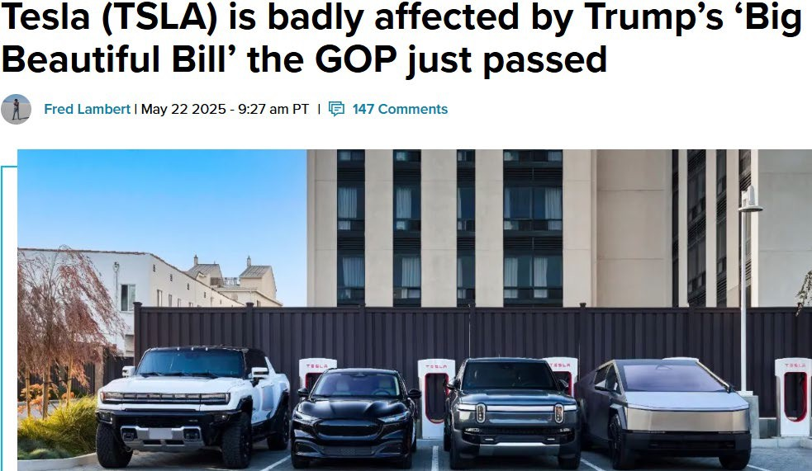
IMPACT ON ELECTRIC VEHICLES
Major Changes to EV Tax Credits
The bill would essentially end the current $7,500 tax credit.
It also creates a new $250 annual fee for EV owners
https://electrek.co/2025/05/22/tesla-tsla- badly-affected-trumps-big-beautiful-bill- gop-passed/

Slide 8
IRA INFRASTRUCTURE GRANTS
The bill also rescinds previously-awarded funding from seven infrastructure programs.
This proposal would impact the grant program that awarded $334 million to Massachusetts for the I-90 Allston Multimodal Project.

Slide 9
WHAT IS NEXT?
Timing for Senate debate on bill is unclear, but there are some initial signals the Senate will make some changes
Once the Senate completes their reconciliation bill, the House and Senate will negotiate a final compromise version
President Trump asked for a final bill from Congress by July 4th

Slide 10
Commercial Real Estate Incentives

Slide 11
Commercial Real Estate Incentives
MOST LIKELY APPLICABLE FOR A BETTER CITY MEMBERS
Incentive | Tax Code Reference | Gov Website Reference | Audience
Energy Efficient Homes Credit | §45L | Link | Single and multifamily home builders
Energy Efficient Commercial Buildings Deduction | §179D | Link | Owners of commercial buildings, designers of buildings for not-for-profit owners
Investment Tax Credit | §48 / §48E | Link | Anyone installing qualifying clean energy property
Alternative Fuel Vehicle Credit | §30C | Link | Properties with alternative fuel sources like electric chargers
Production Tax Credits | §45 | Link | Primarily utility grade renewable energy

Slide 12
COMMERCIAL REAL ESTATE & ENERGY EFFICIENCY
OUR SERVICES
§45L TAX CREDIT
Residential Energy Efficiency
§179D DEDUCTION
Commercial Energy Efficiency
COST SEGREGATION
Accelerated Depreciation
§48E - ENERGY CREDIT
Clean Energy Investment
A “per dwelling unit” credit based on energy efficiency implementations.
For Residential builds, both Single Family Homes and Multi Family Homes.
Pre-Inflation Reduction Act (IRA) (2023) – can credit $2,000 per unit.
Post IRA – can credit up to $5,000 per unit for EE program compliance like Energy Star and Zero Energy Ready Homes (ZERH).
§179D is a deduction for renovations or construction costs of energy efficient commercial buildings.
Upwards of $5.81/sq. ft. can be added back to the budget to help fund updates/upgrades.
A “building agnostic” study that can accelerate depreciation on 15-30% of costs to acquire or build.
A study on an existing building pulls cash out of that building to help fund green upgrades and portfolio expansion.
A study on a renovation could accelerate 30-90% of that cost making much of the cost of potential rehabilitations and updates tax deductible.
Provides a dollar-for-dollar tax credit for businesses, and direct cash payments for state, local, and Tribal governments, non-profits, and other tax-exempt entities, ranging from 30% to 70% of the eligible project cost basis.
Available for various technologies including solar and battery, wind, and geothermal energy systems.
Offers an option to sell or monetize the credit

Slide 13
COMMERCIAL REAL ESTATE & ENERGY EFFICIENCY
§30C TAX CREDIT
Alternative Fuel Vehicle Credit
§45 CREDIT
Production Tax Credit
A credit of up to 30% of the cost to install alternative fuel property (such as EV chargers).
Limited to $100k per item of property.
Up to 0.55 cents per kWh of produced clean energy, depending on source
Primarily only applies to producers at an industrial scale (for example, electric utility providers)

Slide 14
IRA INCENTIVES AND CHANGES
ENERGY GENERATION AND CARBON CAPTURE (DATA UPDATED AS OF 5/22)

Slide 15
IRA INCENTIVES AND CHANGES
CLEAN VEHICLES, MANUFACTURING, COMMERCIAL ENERGY (DATA UPDATED AS OF 5/22)

Slide 16
IRA INCENTIVES AND CHANGES
FUELS (DATA UPDATED AS OF 5/22)

Slide 17
Mark Bacon
Energy Efficiency Practice Lead
mbacon@leyton.com

Slide 18
Q & A

