Slide 1
A BETTER CITY
Energy & Environment Advisory Committee Meeting
8.7.24
Brian Swett, Chief Climate Officer for the City of Boston

Slide 2
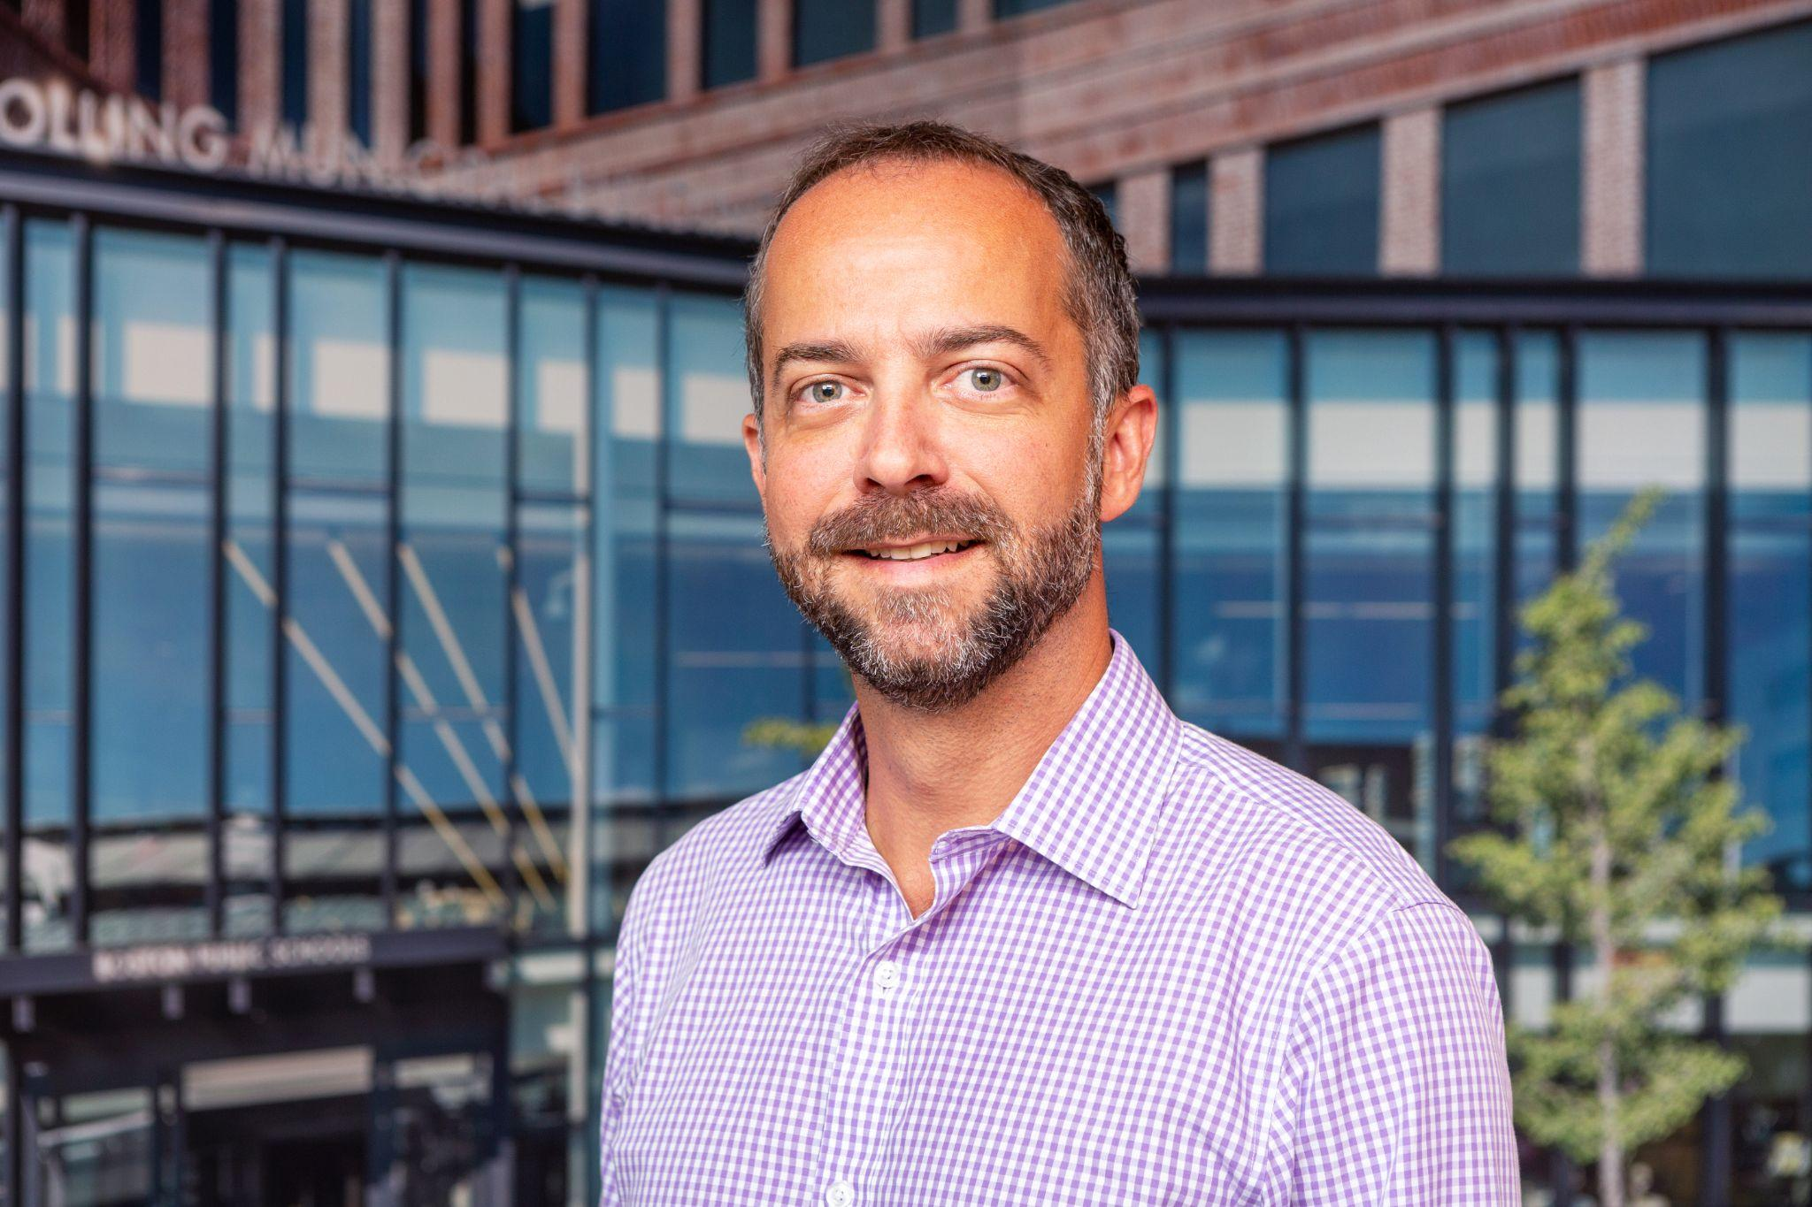
CHIEF CLIMATE OFFICER
This is the first Chief Climate Officer position in Boston.
Priorities of this role include spearheading the Mayor's agenda on climate action while advancing Boston's commitment to sustainability, resilience, and environmental justice.
Leads all of government approach to climate action.

Slide 3
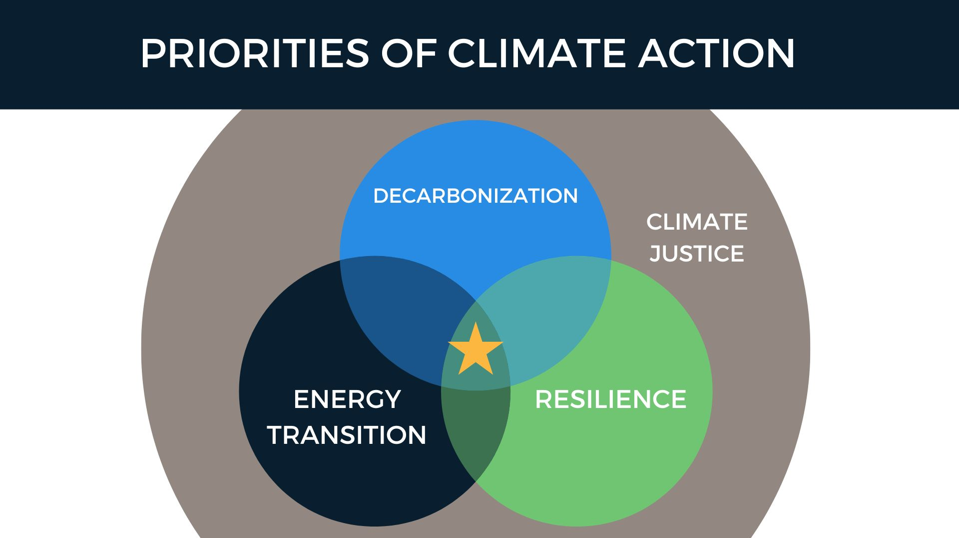

Slide 4
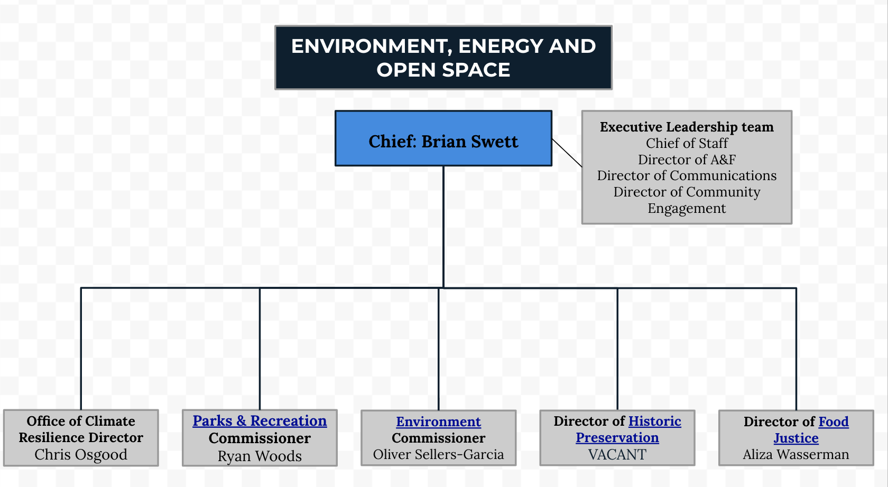
EEOS ORG CHART

Slide 5
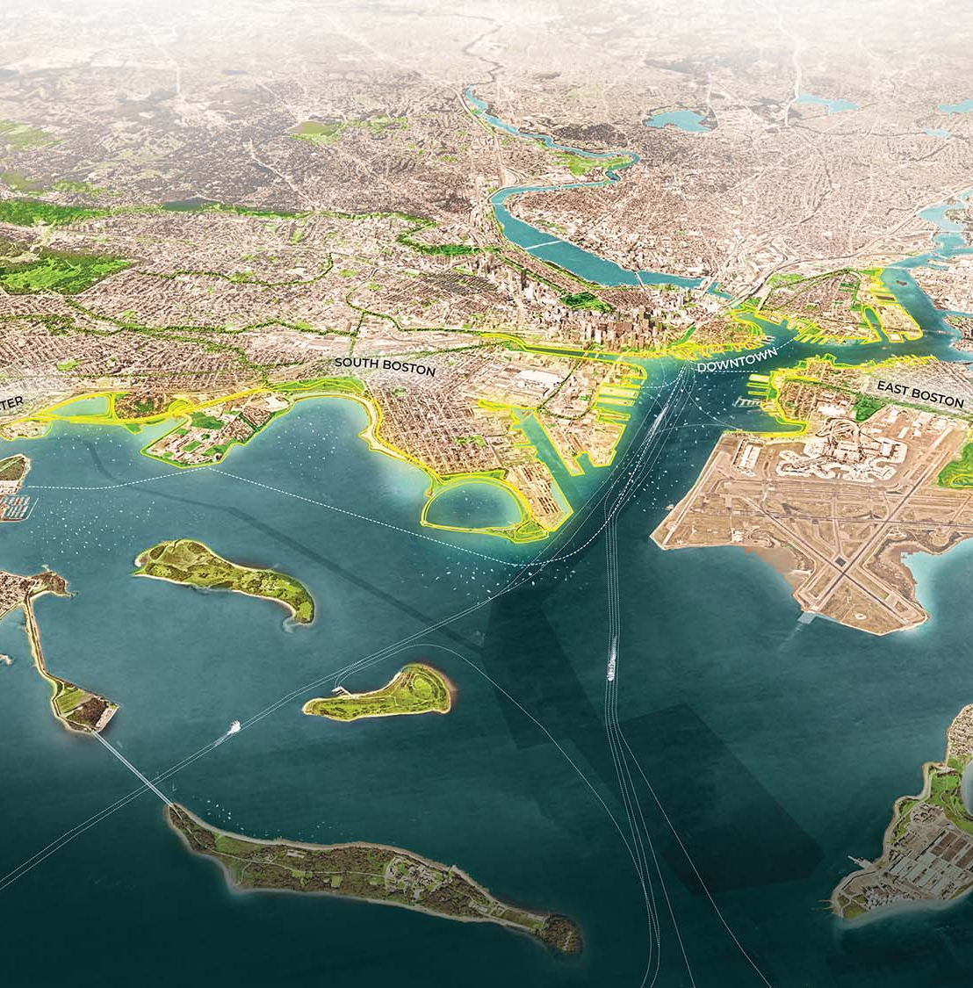
CLIMATE CABINET
One of the immediate responsibilities of the Chief Climate Officer is to create a new Climate Cabinet.
This will be co-led by Oliver Sellers-Garcia, Environment Commissioner and Green New Deal Director.
The creation of this new Cabinet will align with the next iteration of Boston’s Climate Action Plan update.

Slide 6
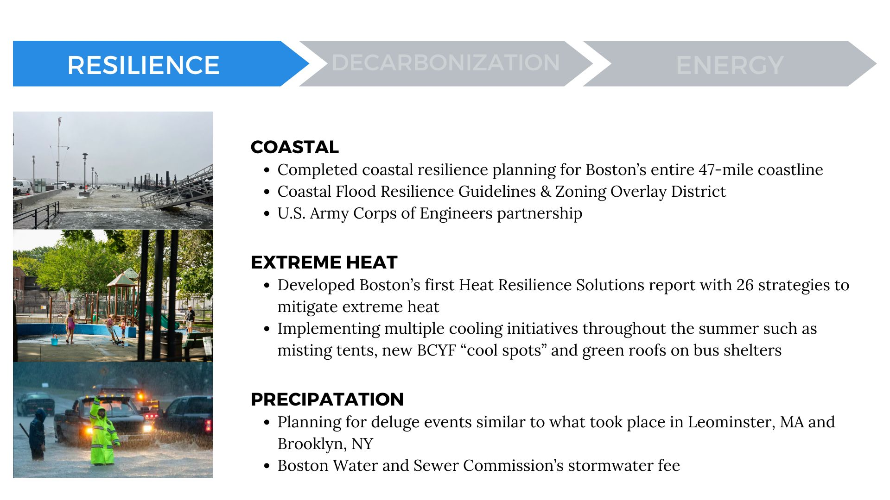

Slide 7
OFFICE OF CLIMATE RESILIENCE
On Monday, the Mayor announced OCR, a dedicated team with the goal of accelerating the citywide response to pressing climate challenges.
The Office will focus on implementing Boston’s Climate Ready Boston coastal, precipitation and heat resilience plans to deliver critical projects.
OCR will be led by Chris Osgood, who also serves as a Senior Advisor to the Mayor.

Slide 8
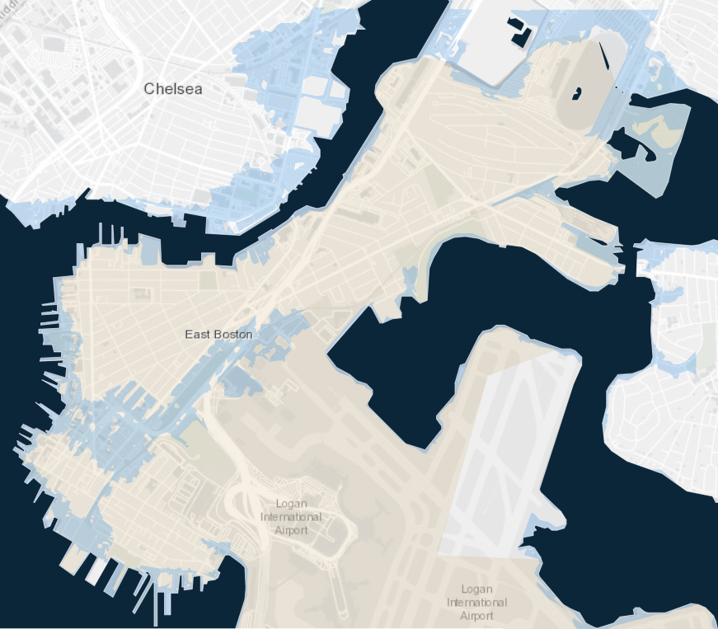
Coastal Resilience Priority Projects: East Boston
Projects under development
1
Bennington Street
1
2
2
Route 1A
3
Border Street
3
4
Carlton Wharf, Lewis Mall
4
Map: 1% Annual Coastal Flood Risk: 2030s; Climate Ready Boston Map Explorer

Slide 9
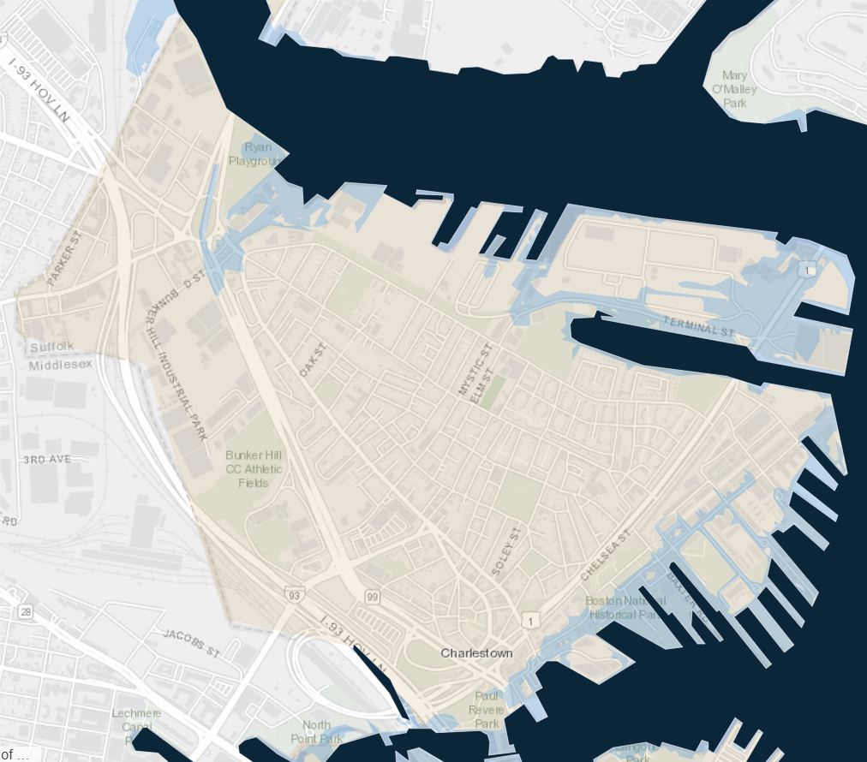
Coastal Resilience Priority Projects: Charlestown
Projects under development
1
Ryan Playground
1
2
2
425 Medford Street
3
3
Deployable at Main Street (Potential)
4
Charlestown Navy Yard
4
5
National Park Service - USS Constitution
5
Map: 1% Annual Coastal Flood Risk: 2030s; Climate Ready Boston Map Explorer

Slide 10
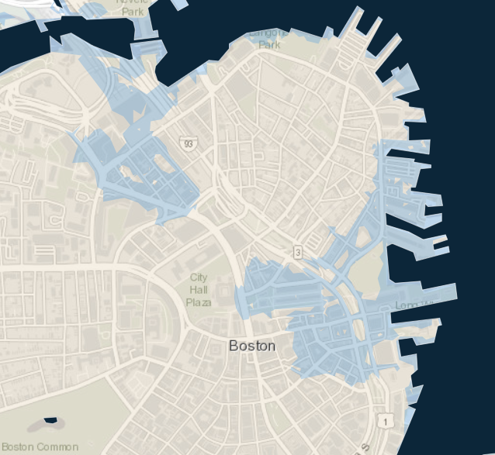
Coastal Resilience Priority Projects: Downtown
Projects under development
1
Charles River Dam
DCR-led effort
1
2
2
South Bank Park
DCR-led effort
3
Long Wharf 2030 Flood Path
3-5
4
5
Map: 1% Annual Coastal Flood Risk: 2030s; Climate Ready Boston Map Explorer

Slide 11
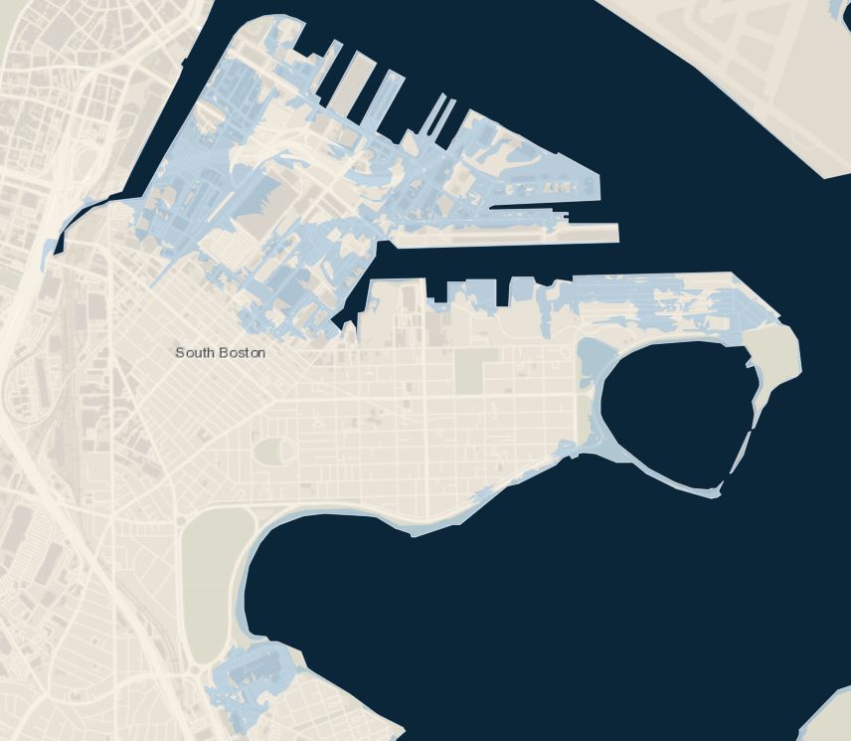
Coastal Resilience Priority Projects: South Boston
Projects under development
1
Fort Point Channel (PDM)
2
3
4
1
Fort Point Channel (Private)
2
3
Seaport Boulevard (Massport)
4
Raymond L. Flynn Marine Park
5
Moakley Park, Moakley Connectors & DBC
5
Map: 1% Annual Coastal Flood Risk: 2030s; Climate Ready Boston Map Explorer

Slide 12
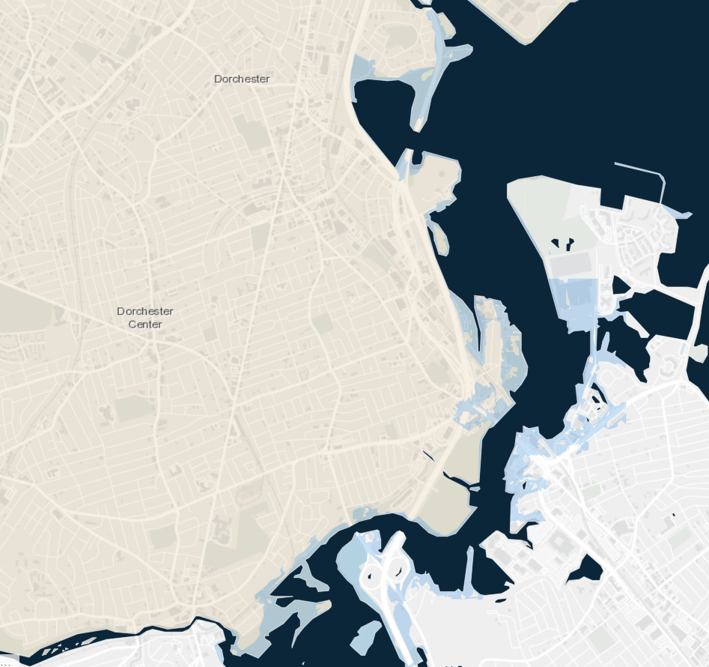
Coastal Resilience Priority Projects: Dorchester
Projects under development
1
Morrissey Boulevard
1
2
Tenean Beach
3
Port Norfolk
2
3
4
Neponset Circle
4
Map: 1% Annual Coastal Flood Risk: 2030s Climate Ready Boston Map Explorer

Slide 13
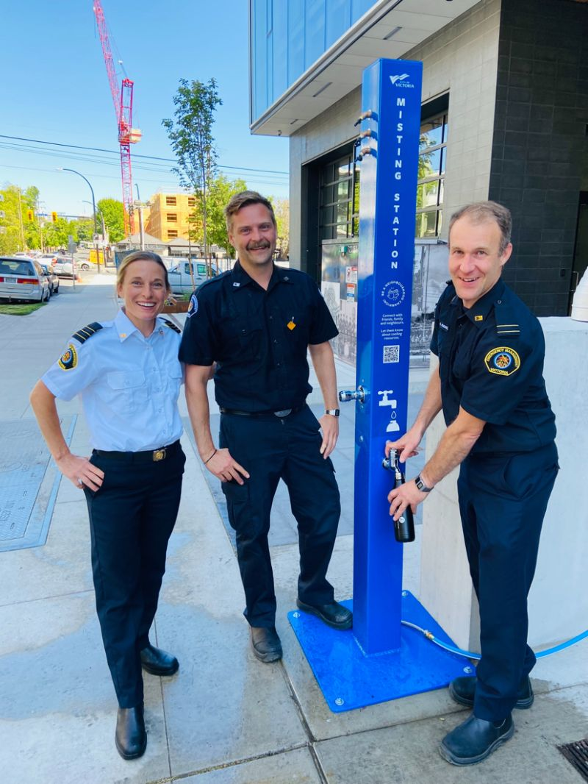
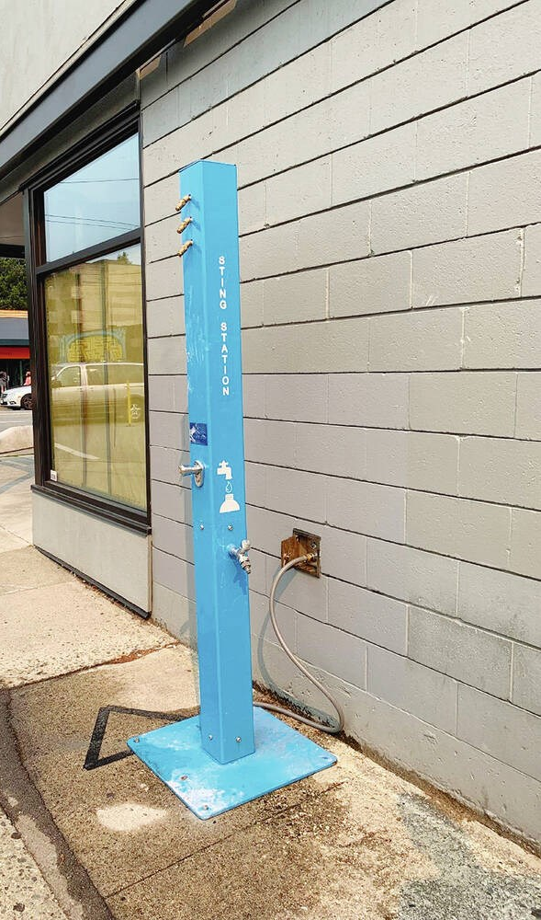
COOLING PILOT: Outdoor Misting Towers
BFD – OEM – MONUM
3 units, hydrant- or hose-fed
Locally-fabricated
To be deployed at fire stations and parks during heat emergencies/ advisories + Open Streets events
Staffed by BFD, OEM
Vancouver, Canada
Notes:
Budget: $10K, SOP: https://docs.google.com/document/d/13C1ZcjUlsq8bb5QLSMXCmi_u2tsZNpssVOe6bN1XYJo/edit
Hydrant cooling station precedents: https://docs.google.com/presentation/d/1ZJlX8liqG4awPzZ49Ia-fRolYk5ecENkBjF-UNhKs1A/edit#slide=id.g1efe727ffd3_0_60
Identify an existing hydrant location located within heat island area with limited water resources and community interest
Explore internal partnerships w/ BFD and BWSC to replicate drinking water and/or misting strategies seen in peer cities (Toronto, Montreal)
Build an operational plan that allows for this approach to be replicated either seasonally or during extreme weather events.

Slide 14
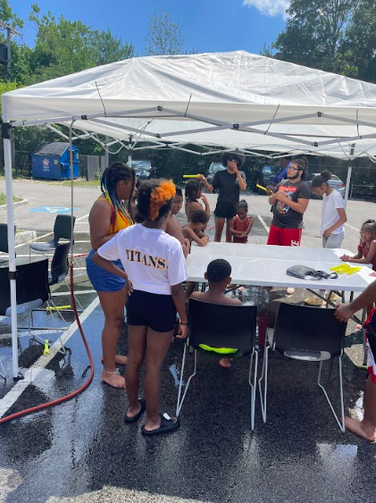
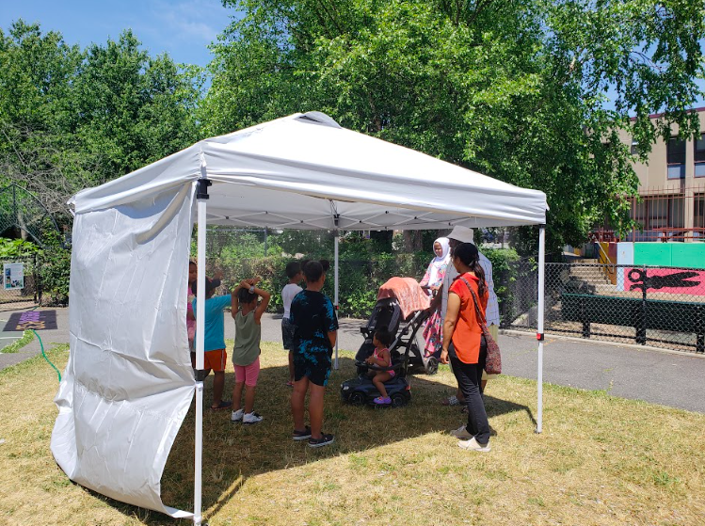
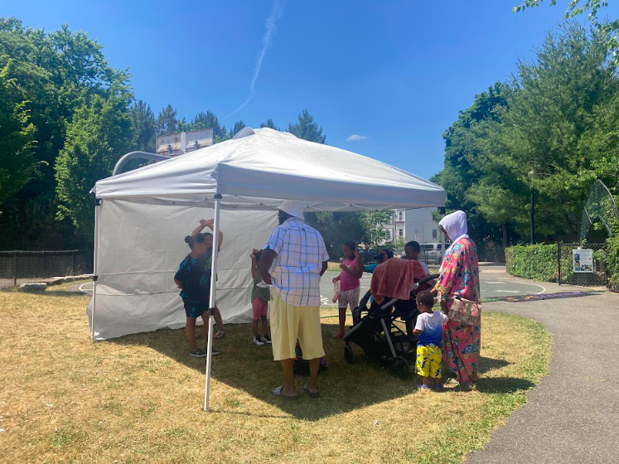
COOLING PILOT: Pop Up Cooling Stations
OEM – BCYF - EEOS – Early Childhood - MONUM
Misting tents for heat emergencies, outdoor events and City workers
Deployed by community orgs or City departments
Office of Early Childhood will offer Pop-Up Cooling Stations in partnership with East Boston CBOs at 2 BCYF locations
Logistics managed by OEM
2022 Cooling Kits
Notes:
Budget: $10,000
Cooling Kit Components: https://docs.google.com/spreadsheets/d/1blISnOjRHTebcm8l2Xao21_r8AEP_X4fpl2oIX2dnxM/edit#gid=1215863377

Slide 15
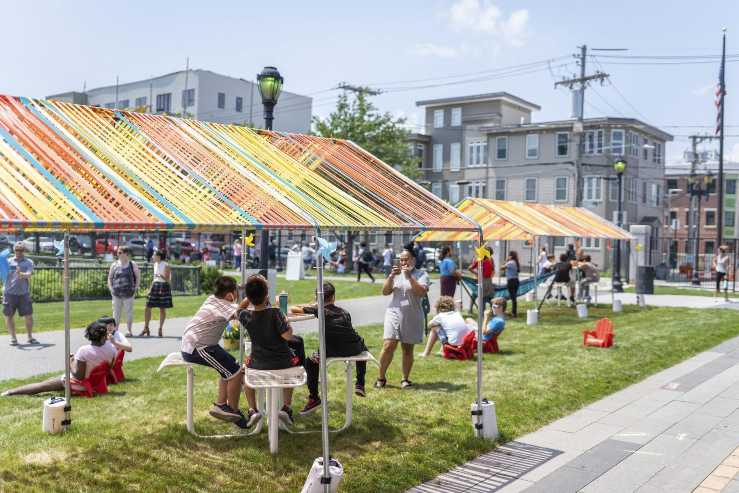

COOLING PILOT: BCYF Cool Spots
BCYF- BPL – EEOS – PFD - MONUM
Expanding successful outdoor cooling locations at 9 BP branges to BCYF centers
Seasonal setups (not permanent facilities changes)
Locations:
  Menino (Roslindale)
  Tobin (JP)
  Gallivan (Mattapan)
East Boston BPL
Notes:
Budget: $40K
BCYF Cool Spots Scope of Work
Partnering with family health centers for programming on heat emergencies/ advisories?

Slide 16
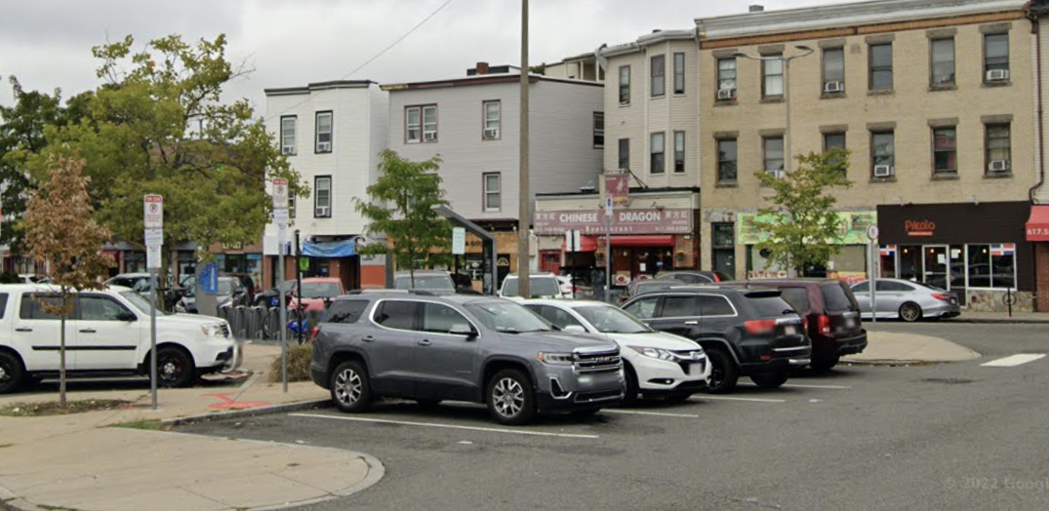
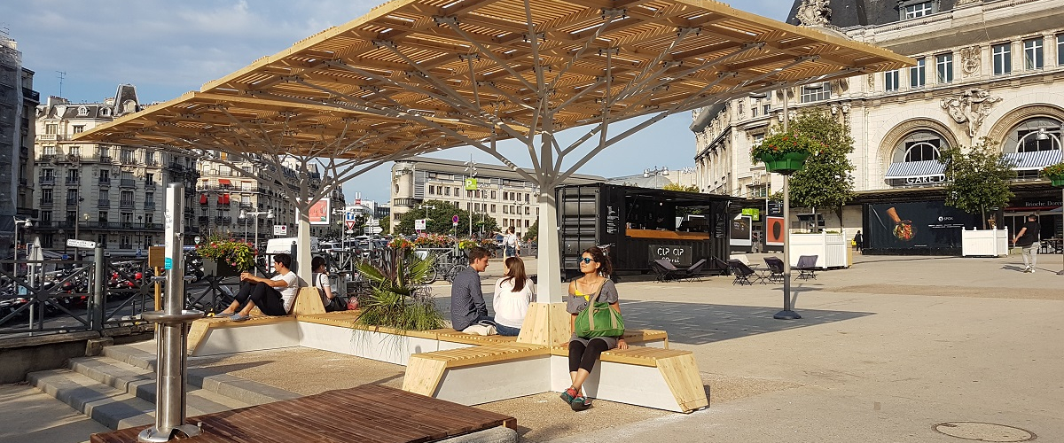
COOLING PILOT: Cooling Plaza (Day Sq)
MBTA - BTD - MONUM
Planned transition from parking lot to MBTA bus stop + plaza
Summer 2024 activation will provide a shaded community gathering space
Local partnerships will provide programming and test options for permanent design
Notes:
Budget: $50k

Slide 17
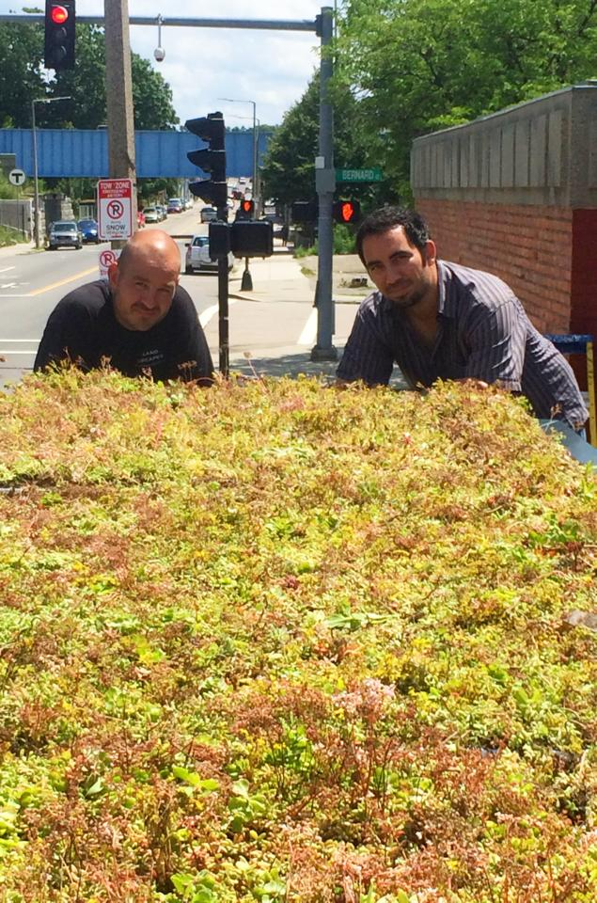
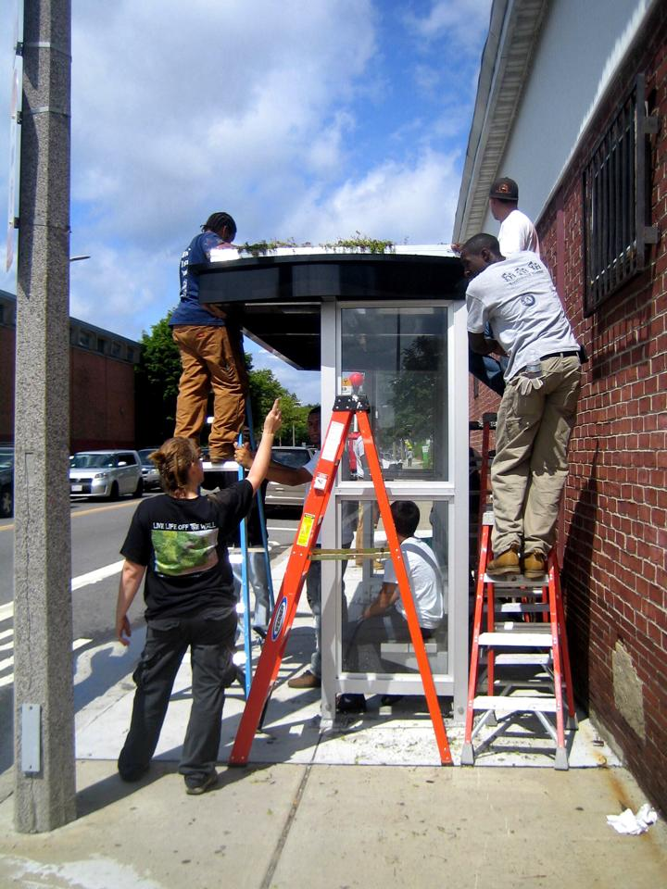
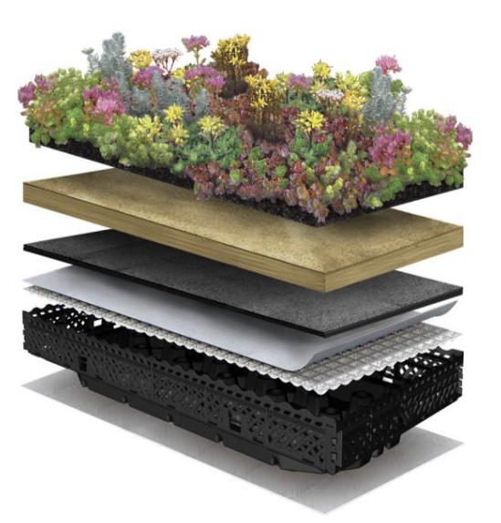
COOLING PILOT: Route 28 Green Roofs
EEOS - OGI - BTD - PWD - MONUM
Social Impact Collaborative, a Boston-based MWBE contractor will install green roofs on 30 existing bus shelters for summer 2024
Improve transit riding experience through:
  decreased microclimate temps
  increase stormwater retention
Training opportunity for PowerCorps
Notes:
Budget: $250K (5 years)
Fairmont article: https://www.ecolandscaping.org/fairmount-line-bus-shelter-living-roof-initiative/

Slide 18
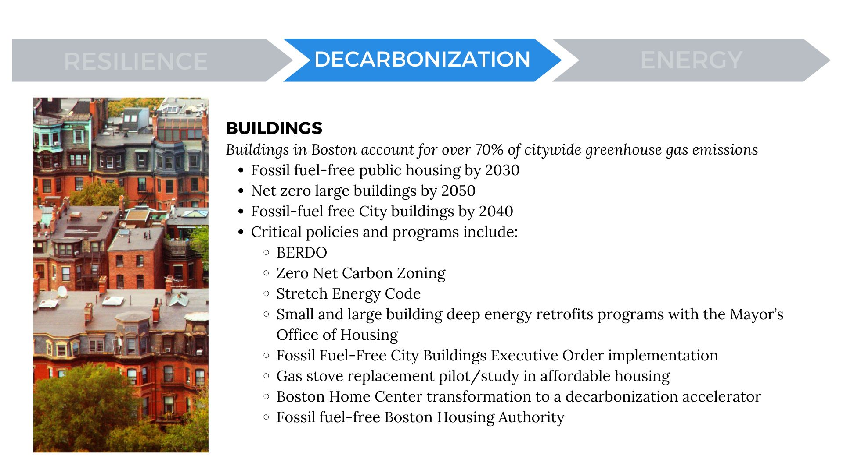

Slide 19
BUILDING EMISSIONS REDUCTION & DISCLOSURE ORDINANCE
The Building Emissions Reduction and Disclosure Ordinance (BERDO) is a
building decarbonization policy that addresses Boston’s largest source of emissions.
  Existing buildings contribute 70% of the total community-wide emissions in Boston.
BERDO requires medium and large buildings in Boston to progressively reduce their greenhouse gas emissions over time to achieve net-zero emissions by 2050.
By complying with BERDO, 5% of buildings in Boston could collectively reduce city-wide emissions by nearly 40%.
BERDO is the most impactful emissions reduction tool we have. Successful implementation is essential to meet our net-zero emissions goal.

Slide 20
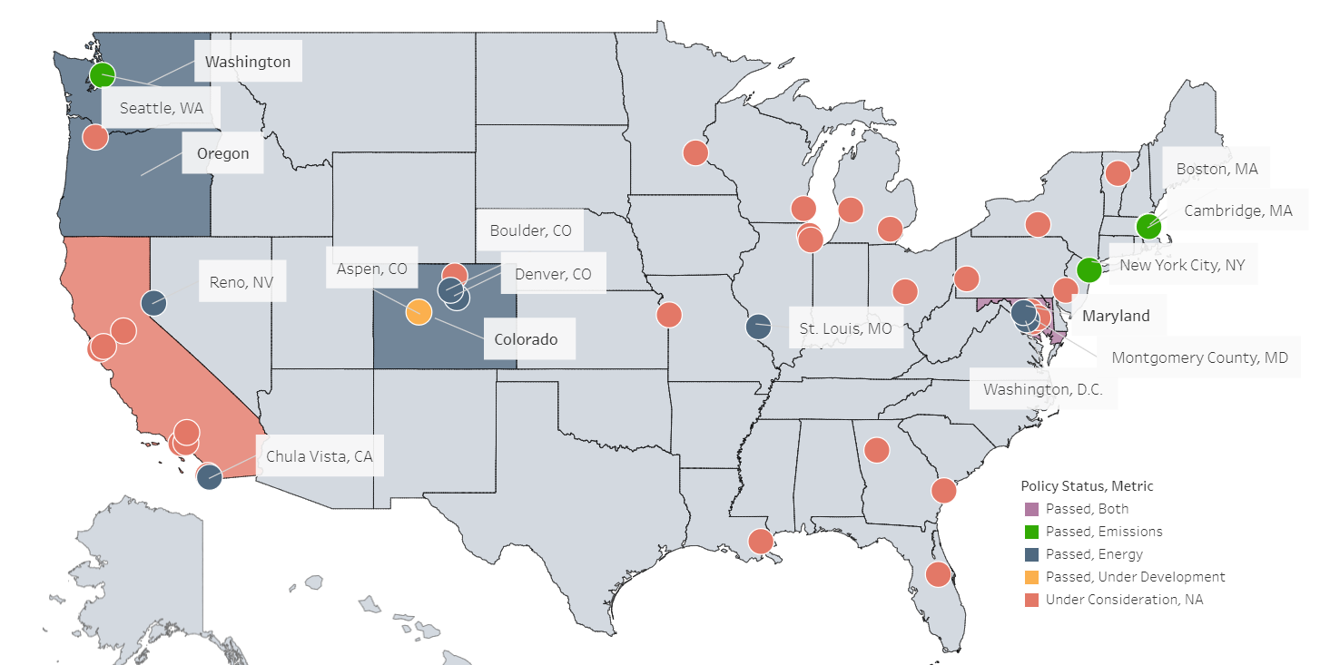
Boston is a national leader in Building Performance Standards
BERDO team is often consulted by other jurisdictions on BPS design and implementation
BERDO is a leading Building Performance Standard in the U.S., and one of the few program of this kind that include an explicit environmental justice components.
Source: IMT
Notes:
AC

Slide 21
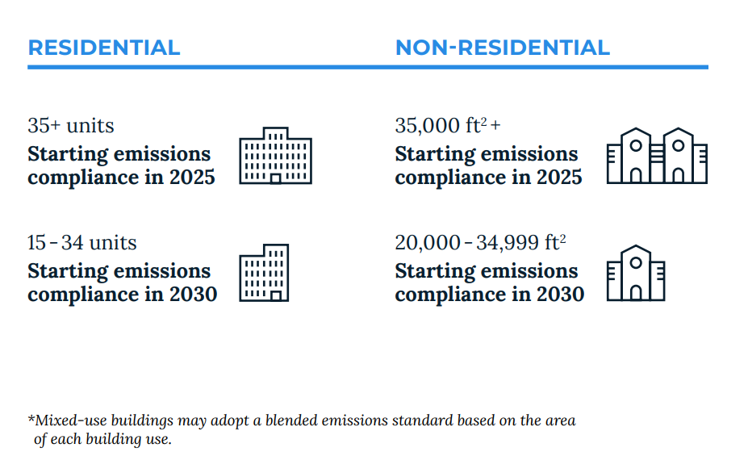
When will buildings need to comply with BERDO?
Reporting and third-party verification of data have been required since 2022.
Emissions compliance will begin in 2025 or 2030, depending on the building size.
Notes:
AC

Slide 22
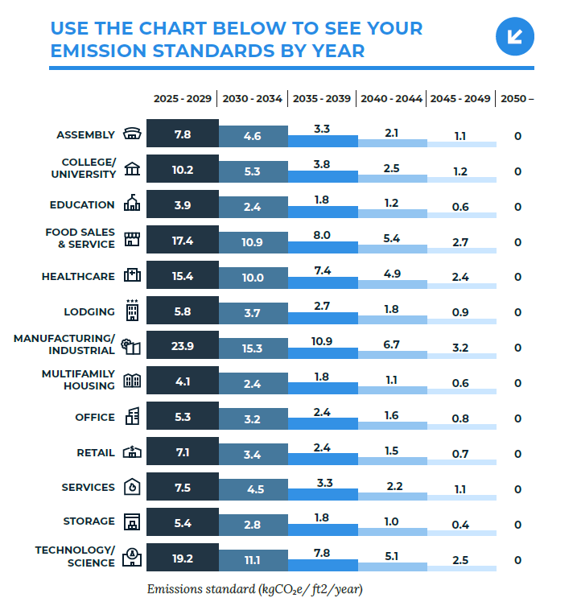
What are emissions standards?
Emissions standards set annual emissions intensity limits for each building use type.
Emissions standards decrease every five years.
All building types are expected to achieve net-zero emissions by 2050.
Notes:
AC

Slide 23



How can building owners comply with emissions standards?
Implementing direct emissions reduction efforts in buildings
Implement building retrofits or improvements. Examples include upgrading to high efficiency electric appliances and lighting, upgrading systems for heating, cooling, water heating, and cooking, improving insulation, tightening window seals, etc.
Using local renewable energy generation or purchasing renewable energy
Use on-site or off-site local renewable generation (rooftop solar, community solar, etc.), enroll into Boston Community Choice Electricity, purchase and retire eligible Renewable Energy Certificates (RECs), or enter into eligible Power Purchase Agreements (PPAs)
Investing in environmental justice communities through Alternative Compliance Payments
Mitigate emissions from electricity and fossil fuel use by making Alternative Compliance Payments (ACPs).
ACPs are collected into the new Equitable Emissions Investment Fund to support building decarbonization projects that prioritize benefits to Environmental Justice communities in Boston.

Slide 24
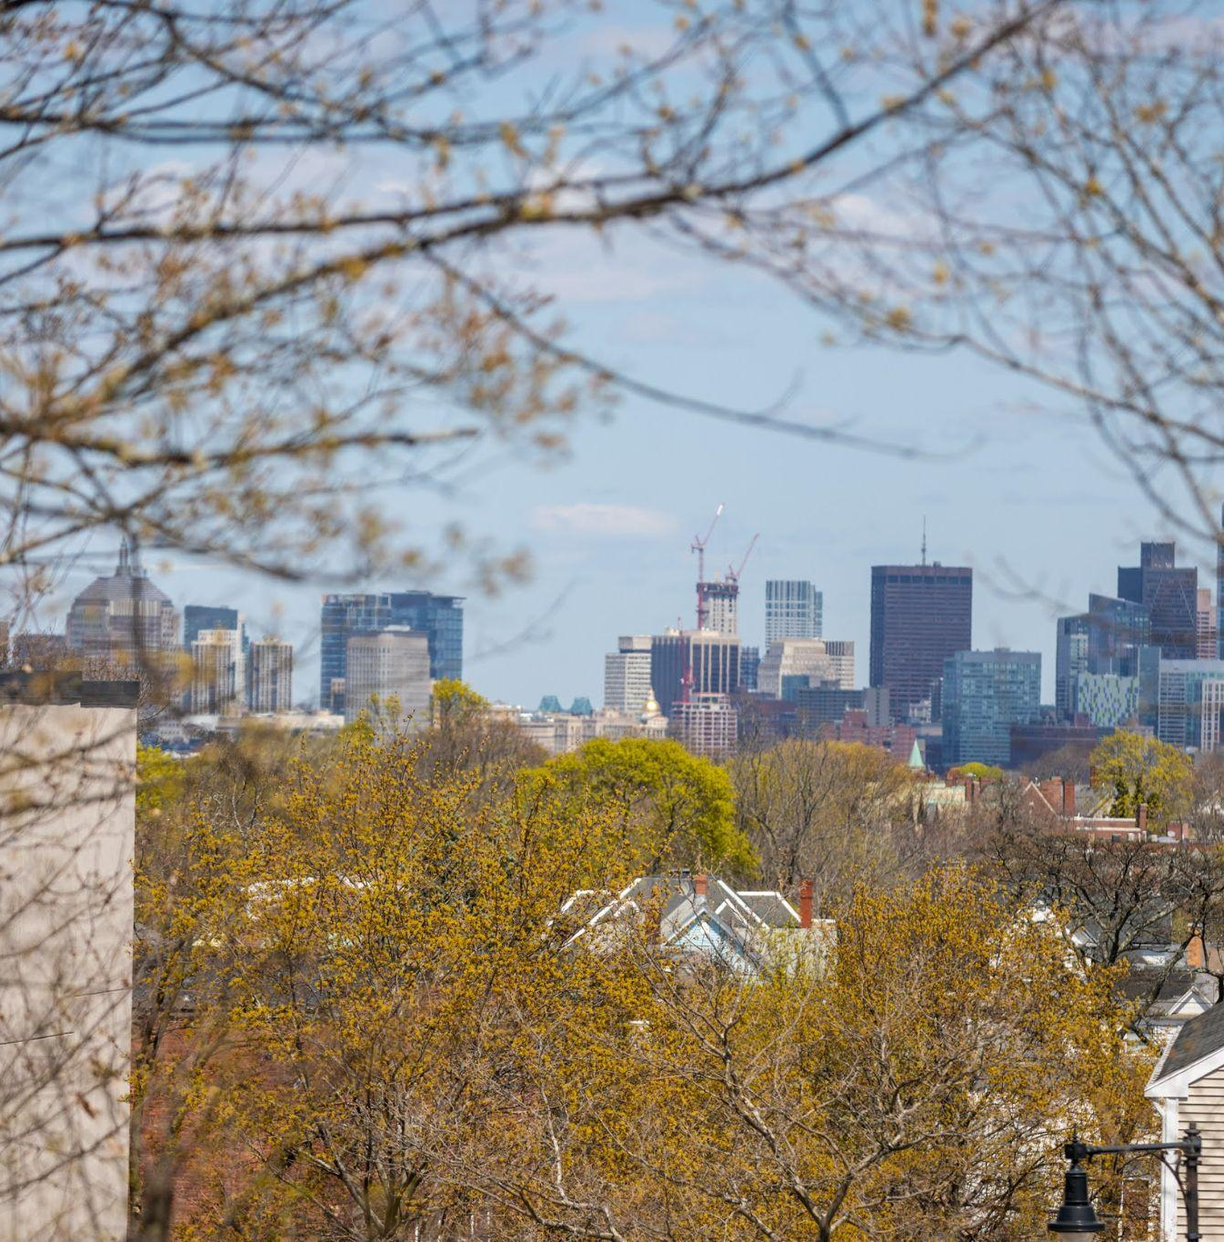
BERDO EQUITABLE EMISSIONS INVESTMENT FUND
Recently closed the first application cycle of the Equitable Emissions Investment Fund.
The BERDO Review Board will evaluate project proposals and will award up to $750,000, with a preference to make multiple awards of about $250,000 each.
The Fund has been seeded with $3.5 million and will continue to be funded.
The Fund was created for the support, implementation, and administration of local building-carbon abatement projects, particularly in EJ communities.

Slide 25



EQUITABLE EMISSIONS INVESTMENT FUND
Alternative Compliance Payments (ACPs) fund future decarbonization projects in Boston’s Environmental Justice communities.
BERDO buildings with emissions over their limits pay ACPs to comply with BERDO
ACPs are a compliance option set at $234 per metric ton of CO2e (from both electricity and fossil fuels) over the emissions limit.
Payments go into the new Equitable Emissions Investment Fund, which is used for building decarbonization projects in environmental justice communities.
Equitable Emissions Investment Fund
collects money
Funds are invested in local building carbon reduction projects approved by the
Review Board

Slide 26
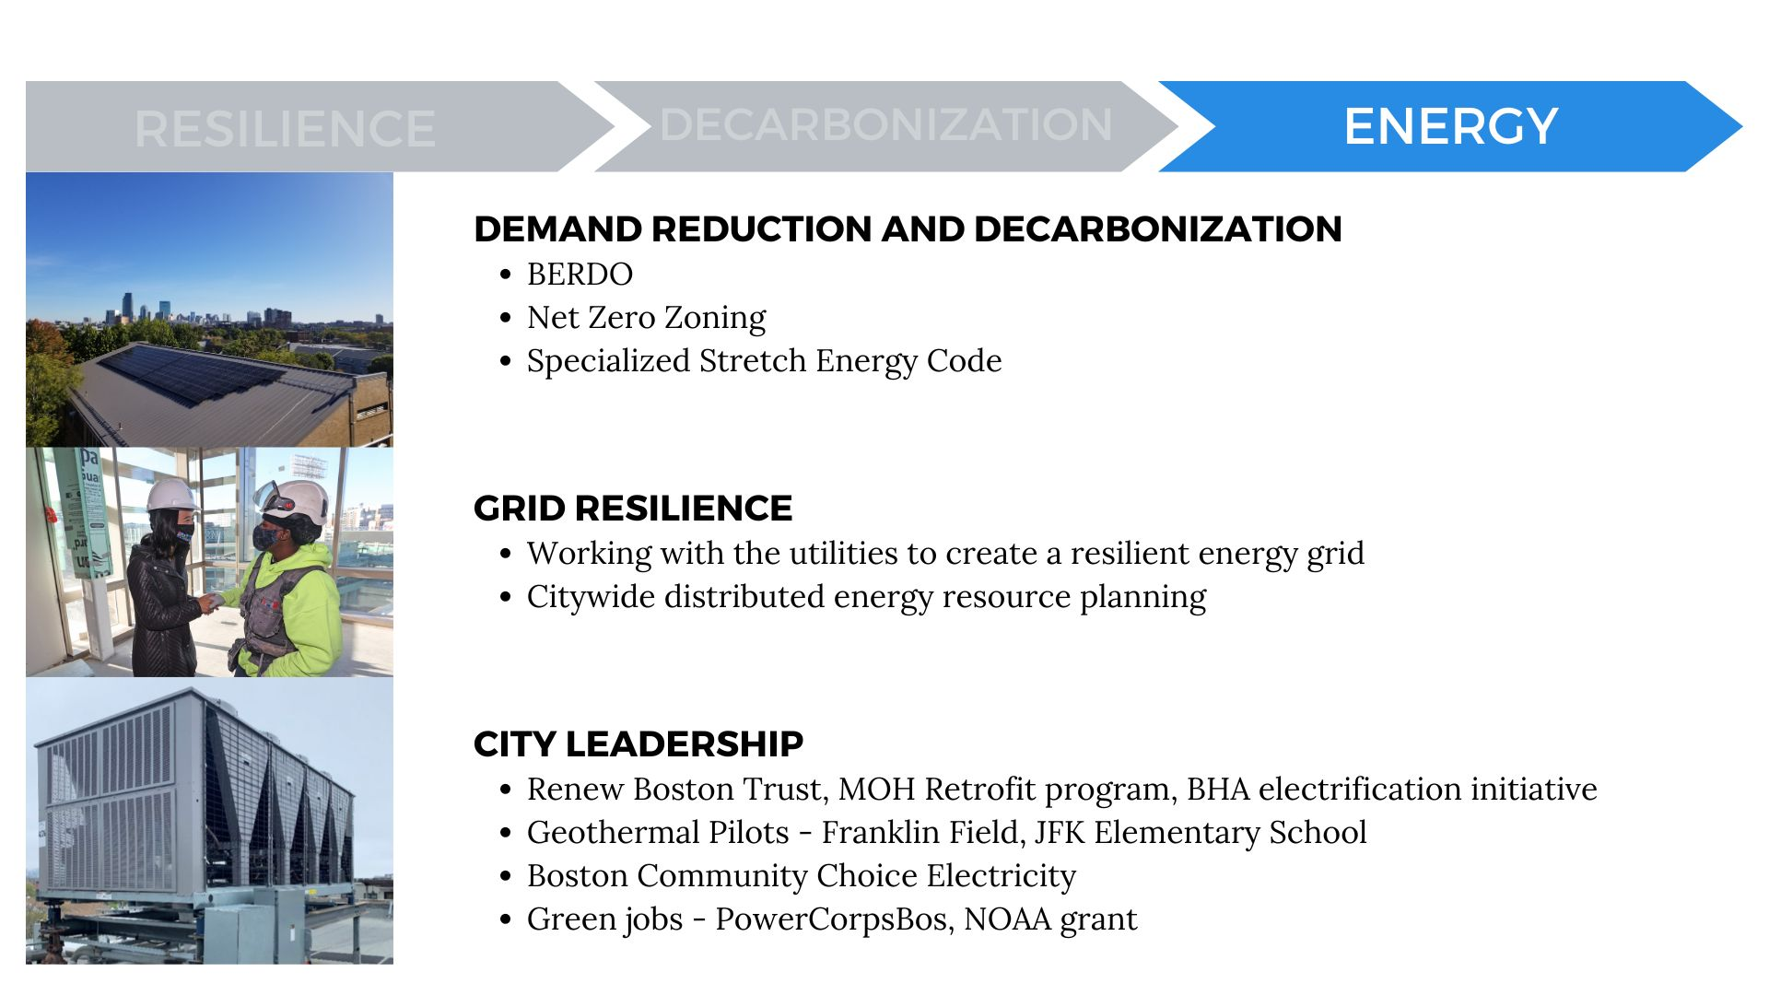

Slide 27
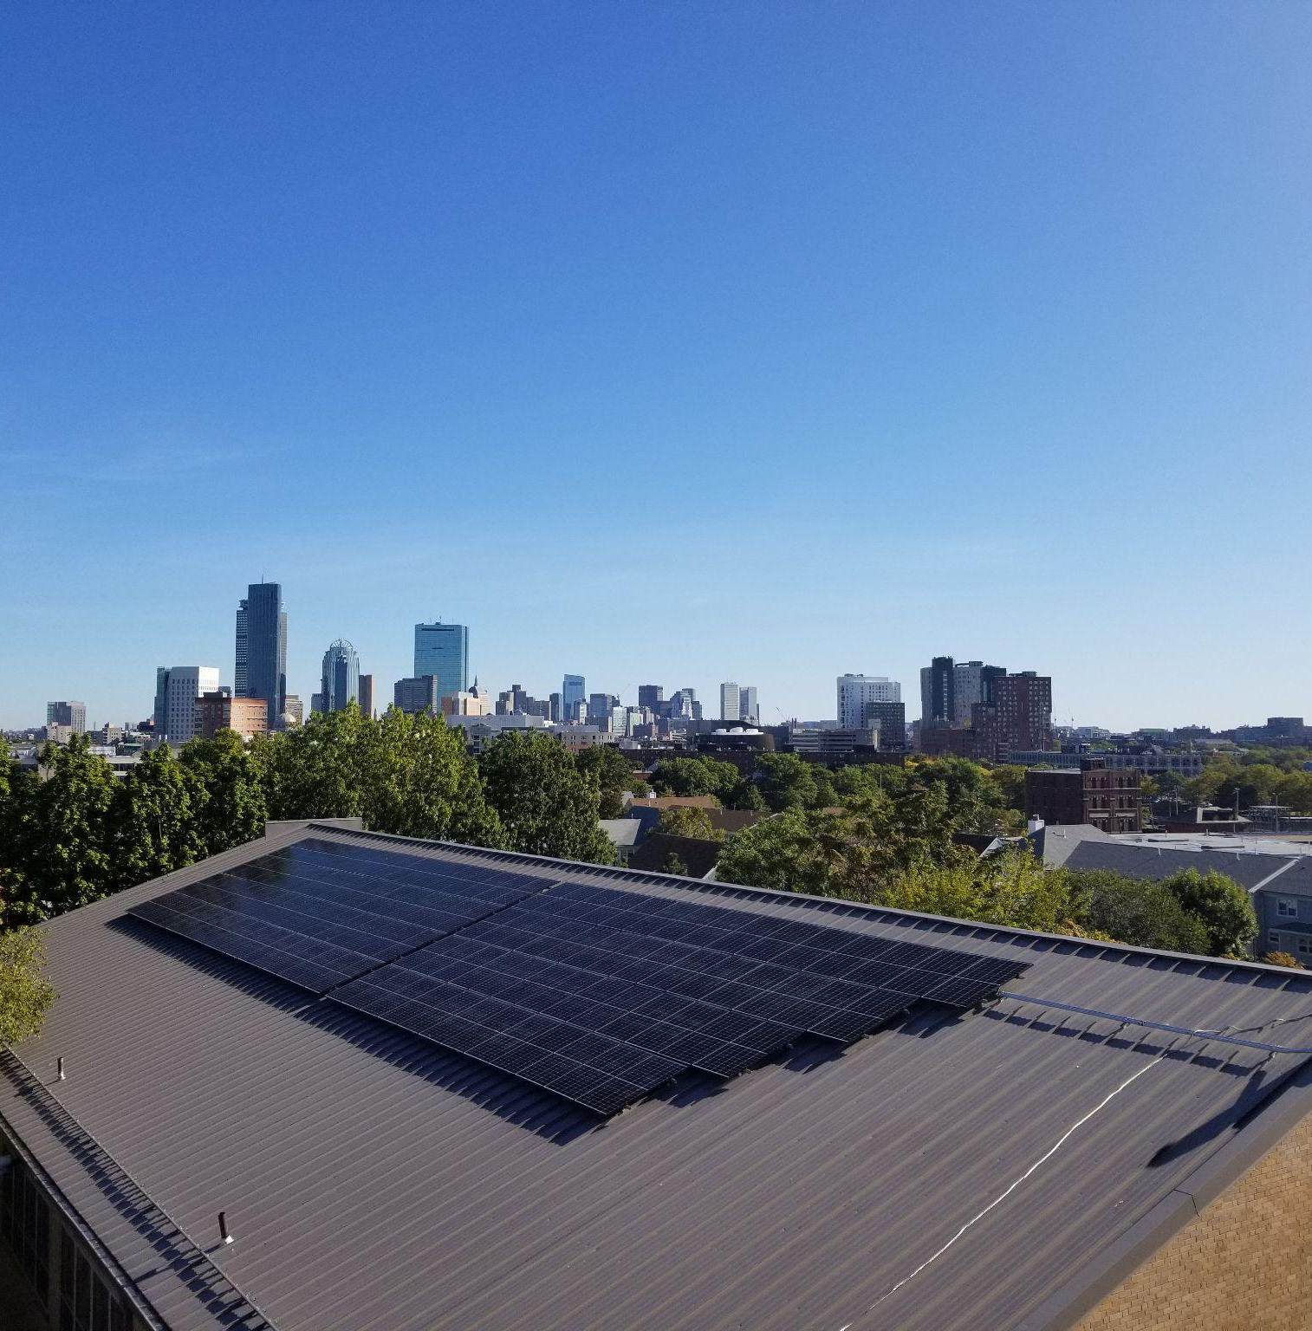
BOSTON PUBLIC SCHOOLS ENERGY INNOVATION
Renew Boston Trust Phase III includes energy efficiency upgrades and renewable energy projects reducing energy use and generating clean energy for municipal buildings, particularly Boston Public Schools.
Active solar projects taking place this summer will generate an additional 2.5 MW in capacity.
Drilling for the first geothermal pilot project in a City building has begun at JFK Elementary School.

Slide 28
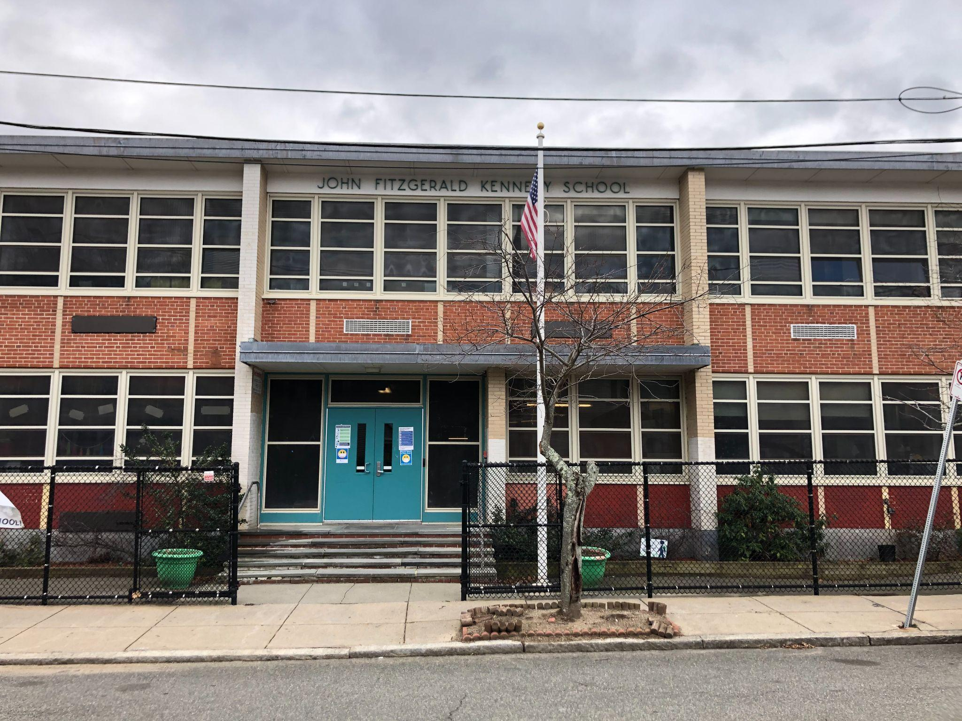
JFK Elementary: All-Electric Energy Retrofit
Construction Schedule
School Year 24-25
Possible 2nd shift work
Summer 2025
Phase 2 vertical geothermal drilling and horizontal trenching, install indoor water source main piping, new interior electrical piping and wires, electric service upgrades, install indoor heat pumps and backup heat, install rooftop units and energy recovery ventilators, install controls, install UV intake plenums, domestic hot water installation
Summer 2024
Geotechnical Analysis (Sample Drilling), install destratification fans, electrical and mechanical rough-in for HVAC mechanical upgrades, Phase 1 vertical well drilling
Summer 2026
Contingency / Reserve
School Year 25-26
Possible 2nd shift work
Scope of Work
DHW Replacements (heat pump)
Building Management System
Heat Pump Heating and Cooling (Geothermal with electric perimeter heat)
Energy Recovery Ventilation
Electrical service upgrades
AC Removal and Reglazing
Benefits:
Same as Otis
Sell Price (million $) | Incentives $ (upfront / annual) | Energy (MMBtu) Savings | Total Annual Utility Savings ($) | Annual Utility Cost Change (Reference: CY 2023) | Annual Demand (kW) Savings ($) | Emissions Reduction
$15.6 | $4,243,062 / $29,361 | 74% | $15,913 | -20% | $(16,709) | 61%
Listed JFK Sell Price is for initial geothermal estimate ($14.1 million) plus a 10% buffer in anticipation of final bid pricing. Direct Pay ITC of 30% is discounted by 15% assuming that proceeds from tax-exempt bonds fund the project.
Sell price for VRF is $9.67 million, upfront incentive: $374,500, annual incentive: $16,477
Costs not included: Eversource service upgrades, ADA and fire protection compliance, window AC removal and facade repair

Slide 29
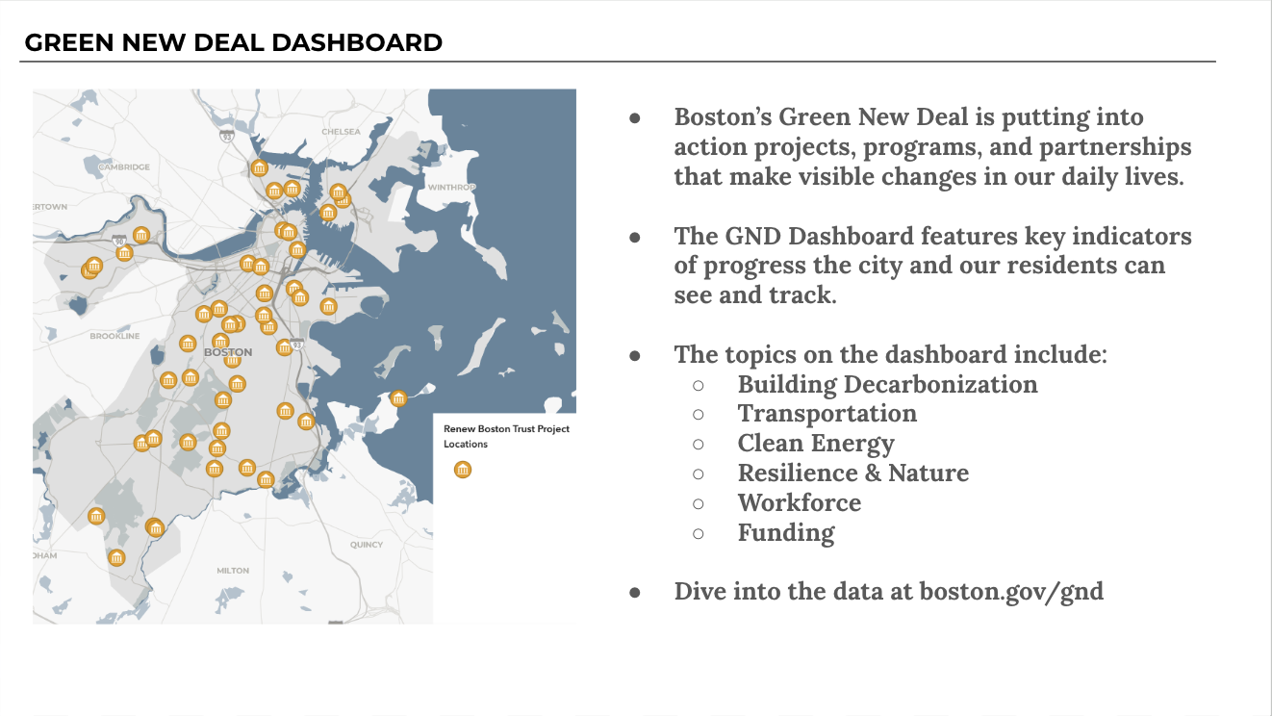
QUESTIONS?

Slide 30
THANK YOU

