Slide 1
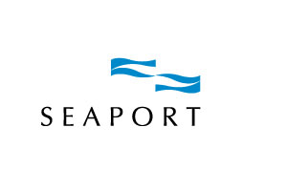

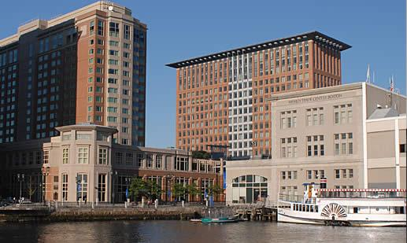
Seaport World Trade Center
One Seaport Lane
Boston, MA
A proud charter member of Boston Green Tourism

Slide 2

Seaport Saves Overview
The origins of our Environmental program date back to 2005 with a request from a group.
100% smoke free
Pure - Allergy Friendly Rooms
Variable frequency drives (VFD)
Bio-EZ Composting
Ozone Laundry
Renewable Energy purchases
Compact Fluorescent Bulbs
Towel and linen reuse program
Bike Program
Smart thermostats
Motion sensors
Hotel Garden
Capacitor bank
Green Weddings Package
Recycling
Green Cleaning
Electrolyzed water
Recycle cooking oil
Local produce procurement
Grander Water Systems
Notes:
Verrill Farm, in Concord, Pio Angelini, in Somerville & Costa Fruit and Produce
Wachusett BioMass recycles our cooking oil
CFLs - 2,012 fixtures were replaced throughout both buildings. These efficiency bulbs last 10 times longer than incandescent bulbs and use 82 percent less energy. We estimate our savings to be 1.3 million KWhr per year (14% reduction)
REC’s – purchase 330 megawatts of renewable energy to power our 13 guest floors, 426 guest rooms and 4 guest elevators
Ozone Laundry System has been a great addition, showing us a 30-35% decrease in chemicals, water/sewer usage and electricity an 80% decrease in hot water generation.
the variable frequency drive (VFD) is the most effective motor controller in the industry today. Modern VFDs are affordable and reliable, have flexibility of control allowing for significant energy savings
The Seaport Hotel employs a capacitor bank to assist with the load shedding of electricity within the hotel. This “smart” meter and its associated sensors monitor multiple zones during peak energy usage periods in the hotel and reduce the electricity needed by 10-20 percent
Sheet and towel reuse program – in 2007, 219k lbs of laundry not processed – an estimated 585k gallons of water saved
Electrolyzed water – electrically charges a saline mixture that produces “sodium hydroxide” a grease cutter and neutral cleaner which holds a ph level of 11.5. The positive charge creates “hypochlorous acid” a sanitizer which holds a ph of 2.5.

Slide 3
Seaport Saves Mission Statement
In a world of limited natural resources, we are committed to reducing the carbon footprint of our operation.
Seaport has created Seaport Saves, a groundbreaking environmental program dedicated to increasing sustainability and conservation throughout all aspects of the organization.
This philosophy allows us to continually source and execute innovative ways to improve our operation in an environmentally responsible manner.
We encourage our guests, team members and vendors to embrace and practice an environmentally sensitive lifestyle as well.
It is possible to coexist in a delicate balance with the natural world while providing world class service in a luxurious setting.

Slide 4




Seaport Saves an Award Winning Program
City of Boston’s Boston Green Business Award in 2007 & Bike Friendly Business Award 2008
Massachusetts Lodging Association’s Good Earthkeeping Award in 2008
MA Department of Environmental Protection
2008 Waste Wise Innovation Award
Seaport was included on Forbes Traveler’s
2008 list of “America’s Greenest Hotels”

Slide 5
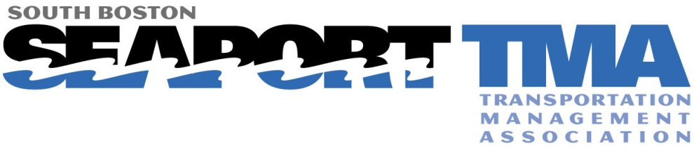
non-profit association of 28 businesses, developers and property managers in the South Boston Waterfront dedicated to easing commutes, reducing traffic congestion and improving air quality.
Seaport Companies Involvement:
1994 co-founder
Leader in Advocating for Transportation Service and Pedestrian Safety
Improvements
Encourage employees and guests to not drive alone through programs/
incentives:
  Bicycle Commuter Group; Annual Bike To Work Week events on-site
  Covered, secure bicycle parking
  Guaranteed Ride Home Program for Employees
  Transit, Carpool and Vanpool Subsidies for Employees
  Zipcar Discounts; Six Zipcars on-site
  MBTA, Transit Schedules Available
  On-Site Alternative Transportation Fairs
Notes:
Lauren Grymek – Seaport TMA’s Executive Director

Slide 6

Seaport Hotel Waste Diversion
Collectively Seaport Hotel experienced a 43% waste diversion between composting and recycling or 206.42 tons in 2008
From 2007 to 2008, Seaport reduced the lbs. of trash per occupied room by 15%
Since beginning Seaport Saves in December 05 we have reduced annual trash tonnage by 29%
In 2007 Seaport WTC complex recycled 557 tons
Notes:
Trash Tonnage
501.84 in 2005
358.49 in 2008 = 143 tons in 3 years
6.88lbs per occ room 2008 vs. 8.12 lbs per occ room in 2007
557 tons recycled = 9465 trees / 2,227,040 KWhrs/1837 cubic feet of landfill

Slide 7
Seaport a Leader in Eco-Innovation
1st Hotel in Boston to provide in-room recycling services to our guests
1st location in New England to use the BioX (Bio-EZ) waste to water system
2nd Hotel in Massachusetts (amongst 2 dozen nationwide) to provide the Pure Allergy Friendly Rooms for those suffering with Allergies and respiratory problems
1st Hotel in the United Sates to use Grander Water Technologies
Among the first five Hotels in the United States to utilize the chemical free cleaning system by the Electrolyzer Corporation

Slide 8
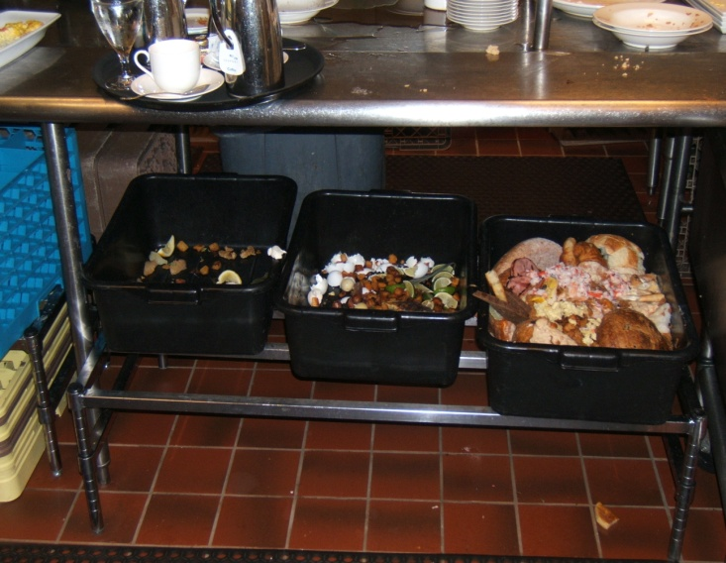
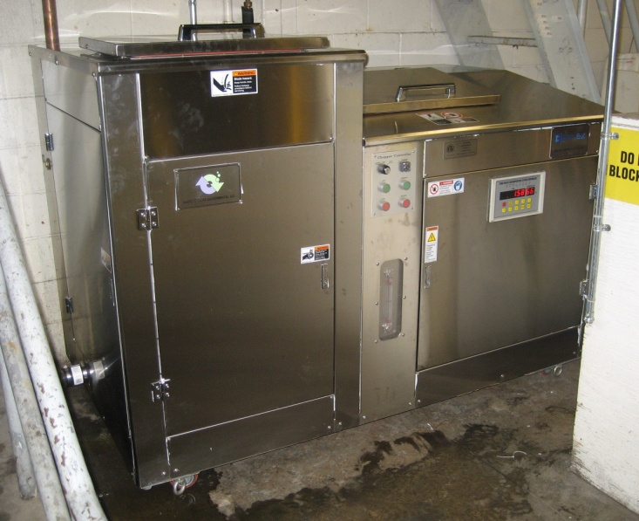
Seaport innovations
Bio-EZ Waste to Water System
A revolutionary biological process that quickly eliminates organic wastes using microorganisms that convert the waste into liquid.
In 2008 we diverted 53 tons of organic waste from the landfill.
Notes:
The traditionalist will say that this isn’t composting as there is no by-product of the process. This is true, but I counter that the Bio-EZ serves two purposes, it reduces the tonnage in the landfill and reduces the carbon footprint of your waste hauling operation by not carting off your organic waste to compositing farms.
The simple footprint allows for any operation to utilize the machine. If I had to estimate I would say that less than 25% of the restaurants and Hotels don’t compost currently. So they simply throw out the waste, because it is easier and allows for odor control. I think that the BioX will open the door for more properties to reduce their carbon footprint and conserve precious landfill space when dealing with their organic waste.
Pre programmed 4 cycle – 45-50 degrees – cold water system – 7.5 PH (use of a PH neutralizer)

Slide 9
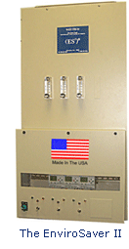
Seaport Innovations
Ozone Laundry System
Ozone Systems uses high voltage electricity to split oxygen atoms (O2) into a highly unstable grouping of 3 oxygen atoms called “ozone gas”.
This man-made chemical transformation also happens in nature, and helps to clean the atmosphere of pollutants. Harnessed in the laundry and injected into a laundry wash cycle this ozone gas acts a very powerful oxidizing, cleaning and bleaching agent.
Because it is a gas, it is able to better penetrate the terrycloth and linen fibers allowing for the use of less chemicals for a faster and more intense cleaning.
This in turn leads to reductions in wash cycles. The savings come as wash cycles are reduced. This leads to a 35% decrease in chemicals, a 35% decrease in water/sewer usage , an 80% decrease in hot water generation and a 30% decrease in electric costs

Slide 10
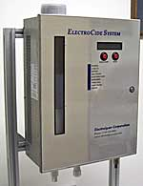
Seaport Innovations
Electrolyzed Water
We currently use a chemical free cleaning system called Electrolyzed Water that transforms ordinary tap water, salt and electricity into a chemical free disinfectant/neutral cleaner. We use it in all facets of Housekeeping and have recently expanded its use in kitchen prep and Stewarding.
Notes:
the Electrolyzer water costs only pennies to manufacture and has a shelf life of 60 days.
This innovative system converts tap water into two cleaning products. It produces two chargers –
The negative charge makes “sodium hydroxide” a grease cutter and neutral cleaner which holds a ph level of 11.5.
The positive charge creates “hypochlorous acid” a sanitizer which holds a ph of 2.5.
The greater benefit of this product is that it doesn’t contribute to indoor air pollution and is absolutely safe to work with. In September 07 two representatives from the Massachusetts State House actually drank the formula to prove how safe it was.

Slide 11
Seaport Innovations
Green Weddings Package
The package allows brides and grooms to honor their commitment to the environment while celebrating their commitment to each other. The package features an array of environmentally sensitive elements including:
~Customized seasonal menu s made with fresh and local organic ingredients
~A private menu planning session with Chef Richard Rayment
~An organic and custom designed wedding cake by Executive Pastry Chef Karen Hodson
~All leftovers recycled through Seaport's Bio-EZ Decomposing System
~Soy-based votive candles, potted plants, orchids and silk trees to decorate the ballroom of you’re choosing
~Contribution to the New England Wind Fund to offset the electricity used during the wedding.

Slide 12

Seaport Innovations
Pure Allergy Friendly Rooms
Provides travelers with allergies or asthma a piece of mind while visiting Seaport.
Every surface within the guest rooms has been professionally treated to minimize irritants, contaminates and odors, allowing for the rooms to be certified hypo allergenic.
This process removes 98.5% of all airborne particulates in a room.
Notes:
70 million people suffer from asthma or respiratory problems in the US
Removes 98.5% of all airborne particulates (9,000,000 to 150,000 in a standard guest room)
A 2005, Cornell University study of patrons regarding allergy friendly facilities suggests:
31% of the surveyed respondents had themselves or knew someone with allergies or respiratory illnesses like asthma. This translates to over 70 million people living in the U.S. alone. These medical conditions may prohibit individuals from full enjoyment in a guest room, without these extra precautions.
83% stated they would prefer to stay in specially treated rooms that removed airborne allergens (81% of those individuals didn’t report to have issues with allergies, but still preferred the treated rooms).
59% stated that the availability of an allergy friendly room would help them choose between similar properties.

Slide 13


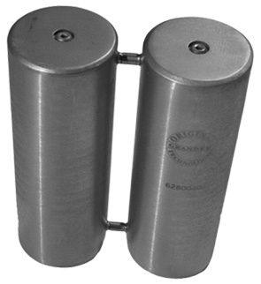
Seaport Innovations
Grander Technology
The system utilizes a novel water-to-water
resonance process to improve the structural
and energetic properties of water
Uses High Grade water to receive and
amplify beneficial energetic structures in
Water
The high-order molecular structure created
actually stimulates beneficial bacteria growth while simultaneously limiting the success of pathogenic populations helping to restore
the natural microbiological equilibrium in the water
Reducing chemical demand, equipment
maintenance, reducing skin and eye irritation and indoor air pollution
Notes:
The first hotel in the United States to use the system
Intended to reduce overall chemical consumption and provide a superior pool experience for its guests, this unique technology enhances the performance of water systems without utilizing chemicals or external electrical power.
This process has a subtle influence upon the structure of the energy transmitted, as compared to the structure of what is received.
Benefits such as reduced chemical demand, reduced equipment maintenance, enhanced microbiological stability, and improved taste and aesthetic qualities of water are all typical results of this system.

Slide 14
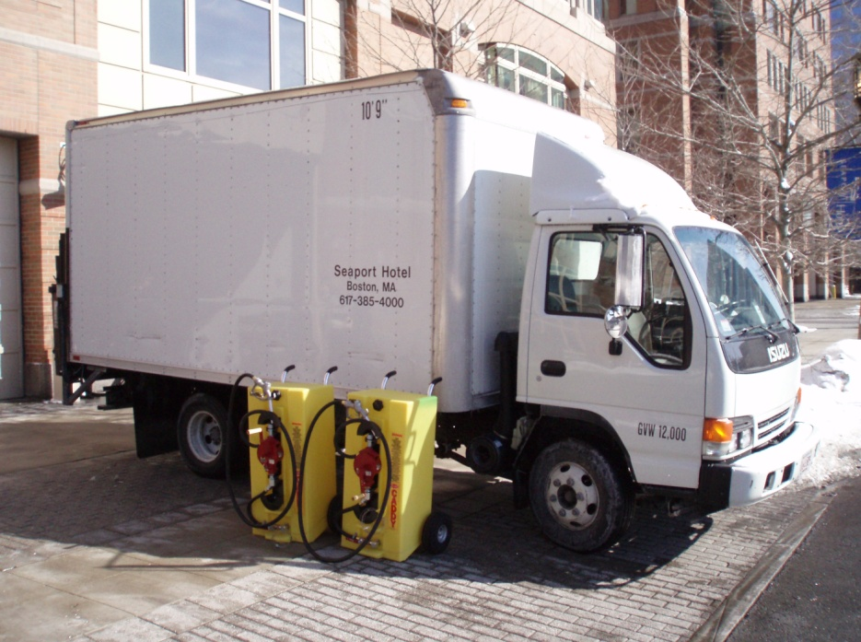

Seaport Innovations
Waste cooking oil to Biodiesel
Wachusett BioMass collects our used vegetable oil from the kitchens and manufacturers bio-fuel as an alternative energy to be used in diesel engines.
It contains no petroleum, so it doesn’t contribute to Global warming.
Biodiesel is biodegradable, nontoxic, and reduces sulfur dioxide emissions.
Notes:
In 2007 Seaport consumed an estimated 108k gallons of cooking oil
(National Renewable Energy Laboratory – September 2001) US Department of Energy
*Biodiesel produces 78% less CO2 emissions than diesel
*Biodiesel reduces air and cancer causing toxins by 94%

Slide 15

Renewable Energy Credits
Carbon Neutral is the process of reducing the net carbon
emissions of an individual or organization by their own actions or through arrangements with a carbon offset provider
Carbon Neutral was the word of the year
in the Oxford Dictionary - 2006
Seaport purchases enough RECs to offset
The energy consumed by all 426 guest rooms, 13 guest floors and guest elevators
Notes:
1 ton of CO2 emissions is = to flying 2,000 miles or running your computer for 10,600 hours
4 tons of CO2 is produced by one Cadillac sedan that travels 10,000 miles
The average US citizen is responsible for 23 tons of CO2 emissions, the global citizen is responsible for 6.5 tons annually
Purchase of renewable energy credits helps to support the development new sources of renewable energy through subsidization

Slide 16
Common Problems
Capital to invest in green initiatives
Favorable ROIs
Finding the vendors
Time constraints
Limited knowledge and resources
Support from local and governmental resources
Possible negative reactions from guests
Notes:
A green Hotel is always in a dance between actual and theoretical returns. Management in many cases wants to spend capital on things that guests can truly experience, enjoy and see value in. So wacky eco-initiatives that defy logic like Electrolyzed Water and Grander Water Systems fall to the waste side because they can’t be truly understood or the ROI like with Solar or Combined Heat and Power may be 5-10+ years

Slide 17
Seaport’s challenges along the way
Changing the perception - Getting staff buy in
and to participate. What is in it for them!
Resistance because initially there were higher
premiums for green products that didn’t work
as well
Lack of competition initially in the market place
allowed for few green product options
Lack of general knowledge and guidance
Certification - LEED and Energy Star
Normal glitches with bleeding edge technology
Notes:
1 Sorting recycling and food at the point of introduction in the waste stream doesn’t take any longer than before, but that is the perception. Be strong and get the staff to buy in
1 Create a green team involving the operation you want to affect positively with the green movement. Seaport’s included staff from culinary, stewarding, convention services, housekeeping, finance, sales, banquets, F&B and other seriously green minded staff members to collectively understand, buy into, trouble shoot and cheerlead to gain momentum.
2 Many green initiatives have very persuasive ROIs and going green is smart business – real savings and free PR should also be taken into consideration. You must Be open to new ideas and products as they seem to evolve with better technology
Remember every eco solution will not fit everyone
There is unprecedented demand in the market for green products, the quality and selection available is great and only getting better
4 This is all new to us – independent research is needed and reliance of corporative associations - like Boston Green Tourism is vital for sharing best practices
5 The age of some of our facilities can be daunting especially when trying to eke out energy efficiencies. This is a very costly process that in some case can never be achieved without razing the building and starting new. Try different ways to gain 3rd party validation – like Boston Green Business Award and MLA recognition.
6 Some calculated risk must be taken if you want to be a trail blazer which will no doubt be offset by the PR if you are first to market

Slide 18

Matt Moore
Director of Rooms and Environmental Programs
Seaport Hotel
Boston, MA
617.385.4511
matthew.moore@seaportboston.com

